Slide 1
Connecting a Camera to a Prosthetic Hand
Authors: Nawaf Salman, Nahel Awidat
Supervisor: Koby Kohai
Submission Date: 30/03/2025
Semester: Spring 2024

Slide 2
Outline
Introduction
Problem Statement
System Architecture
Algorithm Pipeline Overview
Stage 1 – Depth Estimation & Preprocessing
Stage 2 – Object Segmentation (fastSAM)
Stage 3 – Orientation Calculation (PCA)
Stage 4 – Hand Control & Grasp Execution
Thread Synchronization & Communication
Results
Future Work

Slide 3
Introduction
Hand amputees face significant limitations in daily tasks that require grasping and manipulating objects.
Importance of Autonomous robotic hand:
- reduces physical effort for the user
- Enhances quality of life for hand amputees
- Demonstrates how robotics + AI can improve quality of life
Objective: Develop an AI-powered, real-time robotic hand system that can detect, analyze, and grasp objects dynamically using depth sensing and segmentation.

Slide 4
Problem Statement
Challenges:
-segment objects in FOV of the camera with intent of grabbing
-calculate orientation of objects in FOV
-calculate distances between object and camera
-Integrate the camera with a prosthetic hand and controller (stand-alone)
-Achieve full autonomy
This requires a dynamic solution that responds to real-time conditions.
Use AI for segmentation

Slide 5
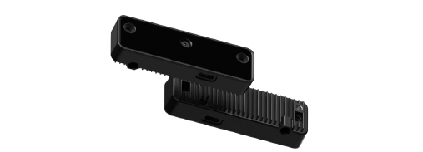
System Architecture
Main Components:
-Oak-D Lite camera (vision + depth)
Depth-sensing smart camera – provides real-time RGB image and depth data, also capable of running neural networks
Our usage:
-Supplies live images for segmentation and precise object distance measurement

Slide 6
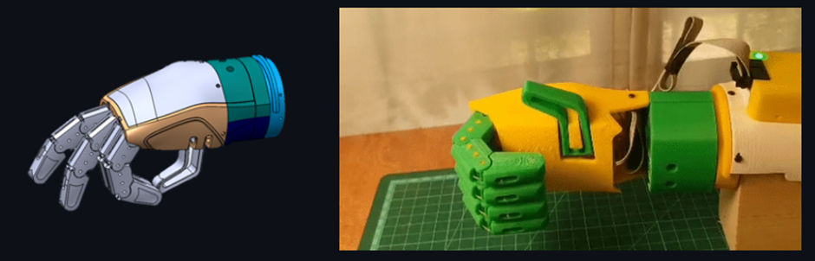
System Architecture
Main Components:
-Haifa3D robotic hand
3D-printed prosthetic hand with motorized wrist & fingers – receives commands via Bluetooth
Integration in project: Acts as the end effector – receives movement commands from Jetson, wrist rotation (align hand to object) and finger closure (grasp object)

Slide 7
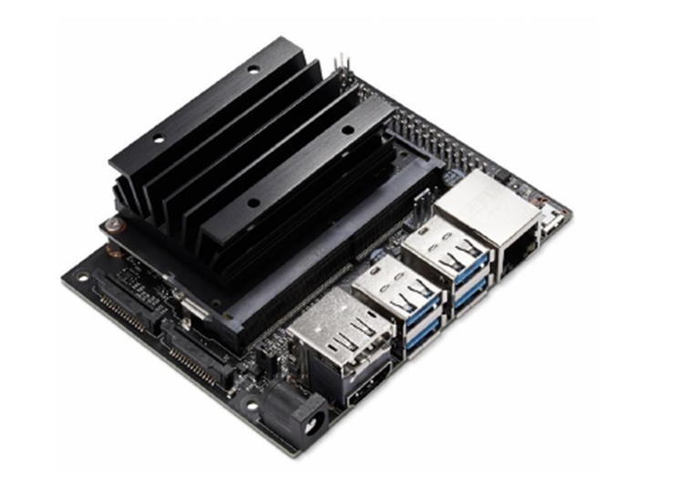
System Architecture
Main Components:
- Jetson Nano (controller)
On-board mini-computer – the “brain” running vision algorithms and hand control logic.
Our usage:
-Processes camera input, calculates object distance & orientation, decides on hand actions
-Communication: Sends rotation/grasp commands to hand via Bluetooth

Slide 8
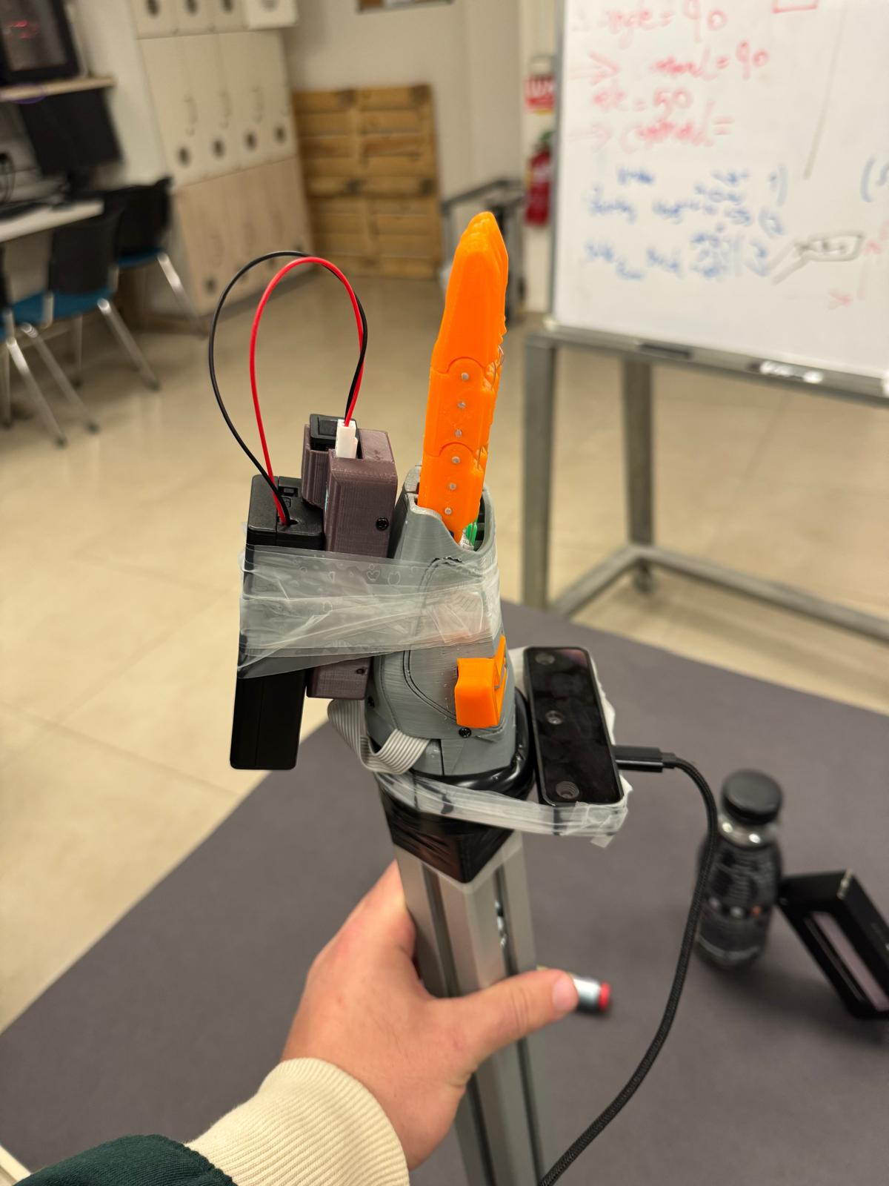
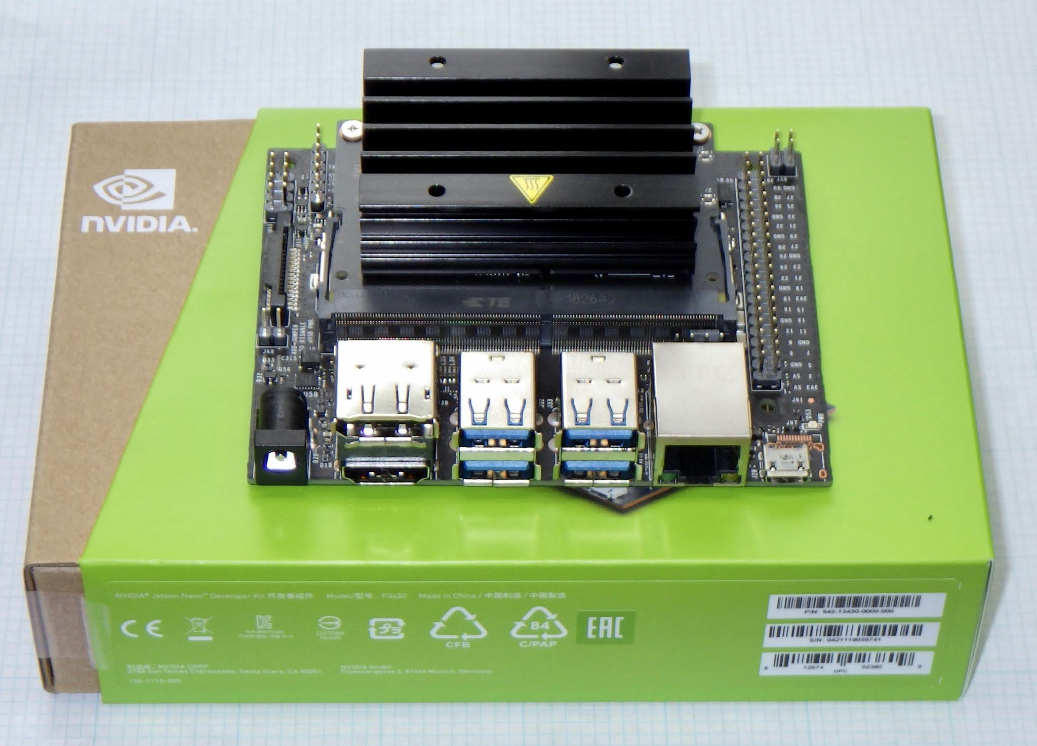
System Architecture
Connectivity: Camera to Jetson via USB Type-C; Jetson to Hand via Bluetooth (using external dongle)

Slide 9
Algorithm Pipeline Overview
Real-time two-thread pipeline: Parallel vision processing and hand control
Stage 1 – Depth Sensing: Capture frame from camera, filter noise, compute object distance
Stage 2 – Segmentation: Use fastSAM model to isolate the object in the scene (mask generation)
Stage 3 – Orientation Analysis: Apply PCA on object shape to find its principal axis (target angle)
Stage 4 – Hand Action: Send commands to rotate the hand and grasp the object if within range
Continuous loop: Repeats continuously, coordinating threads for smooth real-time operation

Slide 10
Stage 1 – Depth Estimation & Preprocessing
Frame capture: Continuously grab frames from the Oak-D Lite camera (RGB image + depth map)
Noise filtering: Apply smoothing filters (moving average, median filter) to raw depth data
Reliable distance: Compute object distance from the camera using depth data (focus on center of frame)
Stabilization: Use moving average over time to avoid abrupt depth changes (important for close range ~12 cm)

Slide 11
Stage 2 – Object Segmentation (fastSAM)
fastSAM model: Lightweight segmentation model (based on “Segment Anything” model by meta) runs on Jetson
Mask generation: Produces multiple candidate segmentation masks for objects/regions in the image
Optimal mask selection: Choose the best mask (largest prominent object, clear boundaries, high confidence)

Slide 12
Stage 3 – Orientation Calculation (PCA)
Extract contour: From the selected mask, get the outline (boundary points) of the object
Apply PCA: Use Principal Component Analysis on the contour points to find the object’s principal axis
Principal axis = object orientation: The angle of the largest variance axis gives the object’s tilt angle
Determine rotation needed: Compare object angle to current hand orientation
If difference < threshold (e.g. 10°), skip rotation (already aligned enough)
If larger, compute the relative angle to rotate the hand for alignment
Grasp trigger check: If object is within grasp distance threshold (e.g. 12 cm), signal a grasp action (hand close)

Slide 13
Stage 4 – Hand Control & Grasp Execution
Command dispatch: Jetson Nano issues movement commands to the robotic hand via Bluetooth
Wrist rotation: If a rotation angle was computed (exceeding threshold), send command to turn hand by that relative angle
Grasping: If object is within range, send “GRASP” command – hand’s fingers close to grab the object
Action sequence: Hand rotates to align, then closes to grasp; after grasp, hand reopens to be ready for next object
Threaded execution: Hand control commands run on a separate thread, allowing continuous vision processing in parallel

Slide 14
Thread Synchronization & Communication
Dual-thread design:
-calc_angle thread: handles vision processing (stages 1–3) and decision making
-hand_control thread: handles executing motor commands (stage 4)
Command Queue: Used to pass instructions from calc_angle thread to hand_control thread safely and in order
Workflow: Vision thread enqueues a “Rotate X°” or “GRASP” command → Control thread dequeues and executes it

Slide 15
Thread Synchronization & Communication
Blocking mechanism: calc_angle thread waits (blocks) after issuing a GRASP command until completion
-Hand_control thread sends an acknowledgment after finishing the grasp, unblocking calc_angle to resume
Angle margin filter: If required rotation < small threshold, calc_angle thread sends a “0°” (no-move) to avoid jitter
Benefit: Threads run in parallel without conflict – continuous image processing and timely hand reactions

Slide 16
Results
Working prototype of a camera-guided prosthetic hand that autonomously aligns and grasps objects
-Demonstrated successful grasp of objects within ~12 cm range without any user input
-Validated real-time integration of Oak-D camera, Jetson Nano processing, and robotic hand actuation
Impact: Shows feasibility of reducing amputee’s effort by offloading grasp tasks to an intelligent prosthetic device

Slide 17
Future Work
Enhanced depth sensing: Improve close-range depth accuracy (e.g. integrate infrared depth sensor)
3D object understanding: Move beyond 2D segmentation to full 3D shape analysis for better grasp planning
Robotic hand upgrades: Add degrees of freedom (wrist/finger articulation) and adaptive grip force for versatility
More computing power: Use a stronger AI processor to run more complex models faster (higher accuracy, multi-model parallelism)

